Slide 1
AiScholar – Connecting Academic Research and its Dissemination
- Be a connector in the field of academic research
Professor Dr Mingfang Lu
Executive President, AiScholar
Guangzhou, China

Slide 2
Heading Text Place Here Line 1
Heading Text Line 2 – Font Size 20pt
Text/Figures/Tables Place Here Fonts size 12 to 14
AiScholar
– Connecting Academic Research and its Dissemination
Be A Connector in the Field of Academic Research

Slide 3
Outlines
1
Overview
2
Activities
3
Resources

Slide 4
Overview

Slide 5
Overview
Founded in 2014, AiScholar is one of the leading innovative network high-tech branding based in China. We are aiming to be the connector for academic research and exchange and always stand at the forefront of China's academic innovation services with strong academic resources and technological advantages, and commit to promote academic exchanges, scientific research and publication services, and talent education to serve scholars with professional solutions and platform. Linking government bodies, universities, research institutions, talents, and R&D industries, etc., AiScholar takes the lead in building a one-stop SaaS academic service internet platform and developing it into a resource link and comprehensive academic ecosystem for research communities at home and abroad, with observing high ethical standard and best practice.
Builder
Promoter
Leader
Practitioner
One-stop Academic Service Platform
Innovative Solutions
Reform of Academic Service Industry
Academic Service Innovation Infrastructure

Slide 6
Development

Slide 7
Activities

Slide 8
Activities
Research & Science Writing Classroom/Tutoring/Q&A/Academic Live Webinars, and Achievement Sharing
One-stop SaaS Solution for Academic Conferences, AI Peer Reviewer Matching, Online Classroom & Live Webinar System
AIS Academy
Solution
Talent Recruitment, Visiting Scholars & Studying Abroad, Achievement Transformation
AIS
Talent
Global ThinkTank
Community for Global Scholars & Peer Reviewers
Online
Tools
AIS
Online Database for Papers Submission & Journal Matching
Publication Support
Publication Support for Authors & Journals
Academic Conferences
Academic Headlines
One-stop Platform for Conference Organizations
Media for Research Frontiers, Hotspots & Tips, Journal Intelligence, Industrial Reports

Slide 9
Activities
Online SaaS Solution for Academic Conferences
Planning
Invitation
Stats & Analysis
Registration
Organization
Management
Event Planning
Event Promoting
On-site Management
Live Streaming
Proposal Editing
Website Establishment
Distribution Channels
Channel Effectiveness Testing
Electronic Check-in
Dining System
Broadcast Service
Event Recording
`
1
2
3
4
5
6
7
8
Registration
Data Collection
Interactive Activities
Data Analysis
Online Registration
Online Payment
Agenda Adusting
Conference Material
Participants Data
Financial Data
Paper Data
Award Evaluation
Theme Forum
Exhibition
Participants Analysis
Financial Analysis
www.aischolar.org

Slide 10
Activities
Publication Support for Scientific Papers
Confirmation for Journal Submission
Manuscript Submission Guidance
Final submission
Online Submission
Template download
Expert Pre-reviewing
Service
Chain
AI Reviewer Matching
Pre-submission expert reviewing
Intelligent reviewer matching
Automatic manuscript assignment
Manuscript Revision Assistance
Peer Review Organization
Editing online
Check reviews online
.
www.aischolar.org

Slide 11
Activities
Journal Publications
AiScholar currently publishes two journals, HCIN and JAIMS
Also help external journal launches in ISSN assignment, develop journal homepage, and provide journal content hosting service
Provide online submission editorial and peer review system
Offer journal production, publication, and metadata optimization
www.aischolar.org

Slide 12
Resources

Slide 13
Social Media Promotion
Covering all research domains and subject areas
Mechatronic Information
Materials Sci & Engineering
AI Scholar
（Service Account）
AI Scholar +
（Subscription Account）
Computer Sci & Information
Green Energy & Environment
AI Scholar
（Mini Program）
Academic Exchange Information Center
Humanities and Social Sciences
STEM

Slide 14
Collaboration Resources
Scientific Organizations
Collaboration with STM Publishers
We have established long-term cooperation with many famous international publishers, such as Springer, Elsevier, IEEE, IOP science, IOS Press, EDP, Academic Press, ASME, American Scientific Publishing, CRC Press/Balkema, DEStech Publications, SPIE, TTP, AAPH, ACM, AIP, IET, Scitepress and Atlantis Press, etc., to provide more international publication services. And we continue to establish in-depth cooperation with academic journals, such as SCI & SSCI journals, EI journals, Peking University core journals, CSSCI & CSCD journals, etc.
With years’ development, there are thousands of collaborated organizations on our platform, including universities, colleges, institutions, and scientific enterprises. South China University of Technology, Beijing Jiaotong University, Tsinghua University, North China Electric Power University, National University of Defense Technology, Sichuan University, China national institute of standardization, China Institute of Water Resources and Hydropower Research, Nanyang Technological University, Seoul National University etc.

Slide 15
Media Partners

Slide 16
Partner Portal Websites

Slide 17
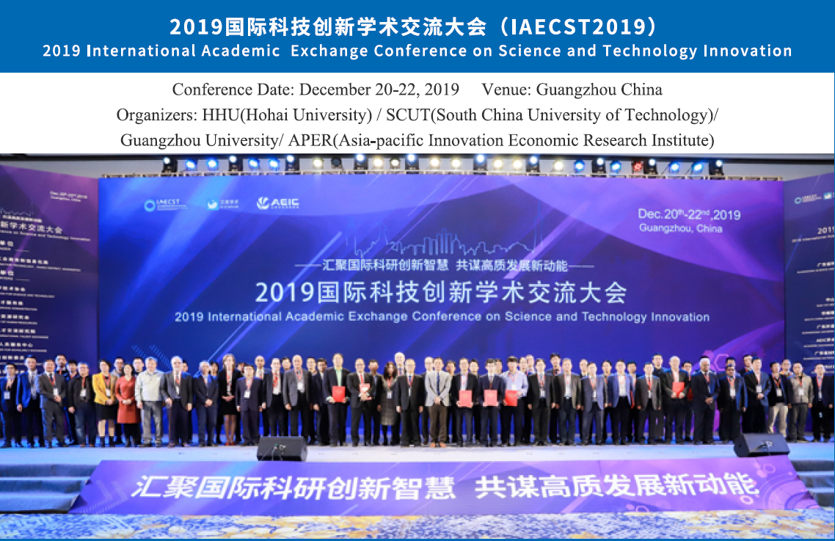
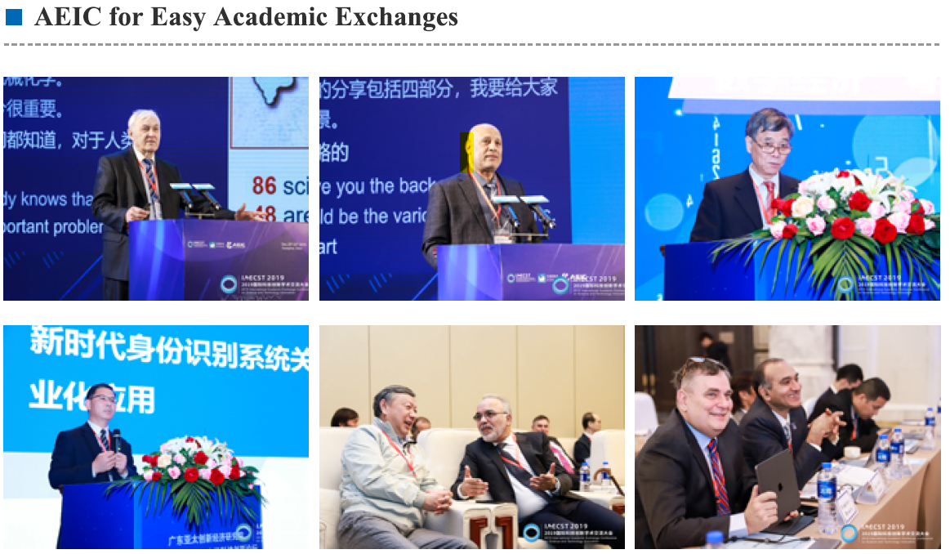
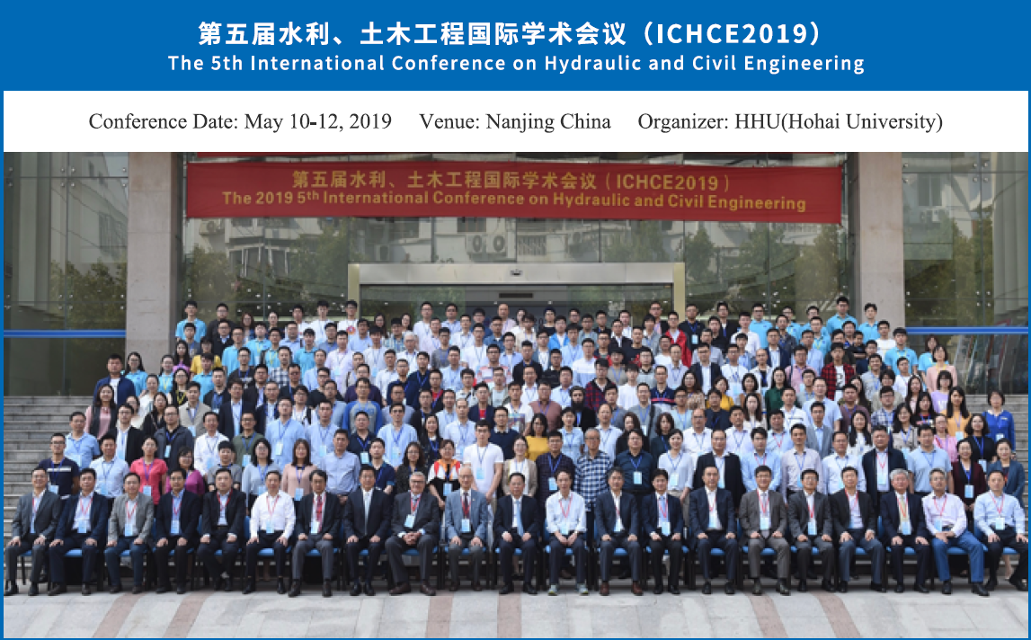
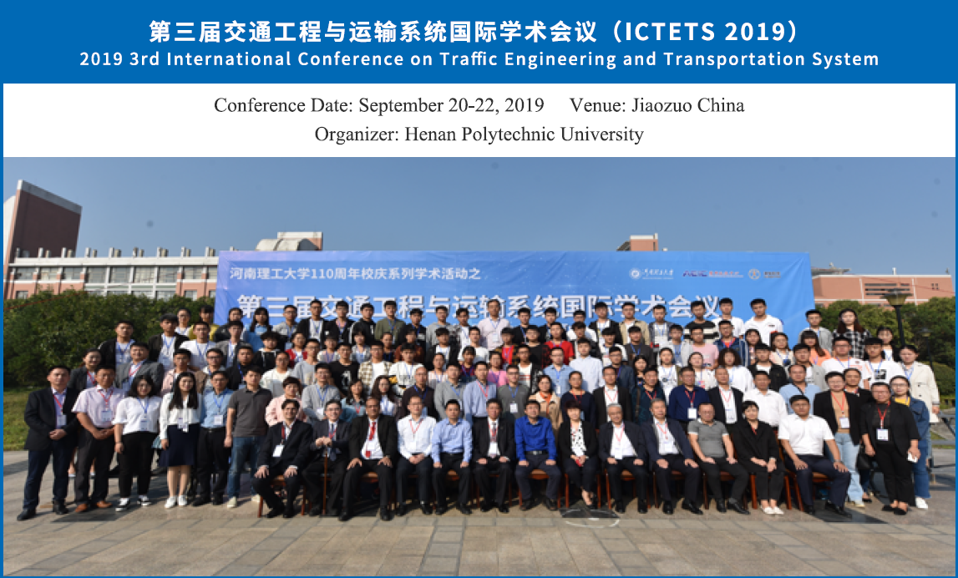
Excellent Cases

Slide 18
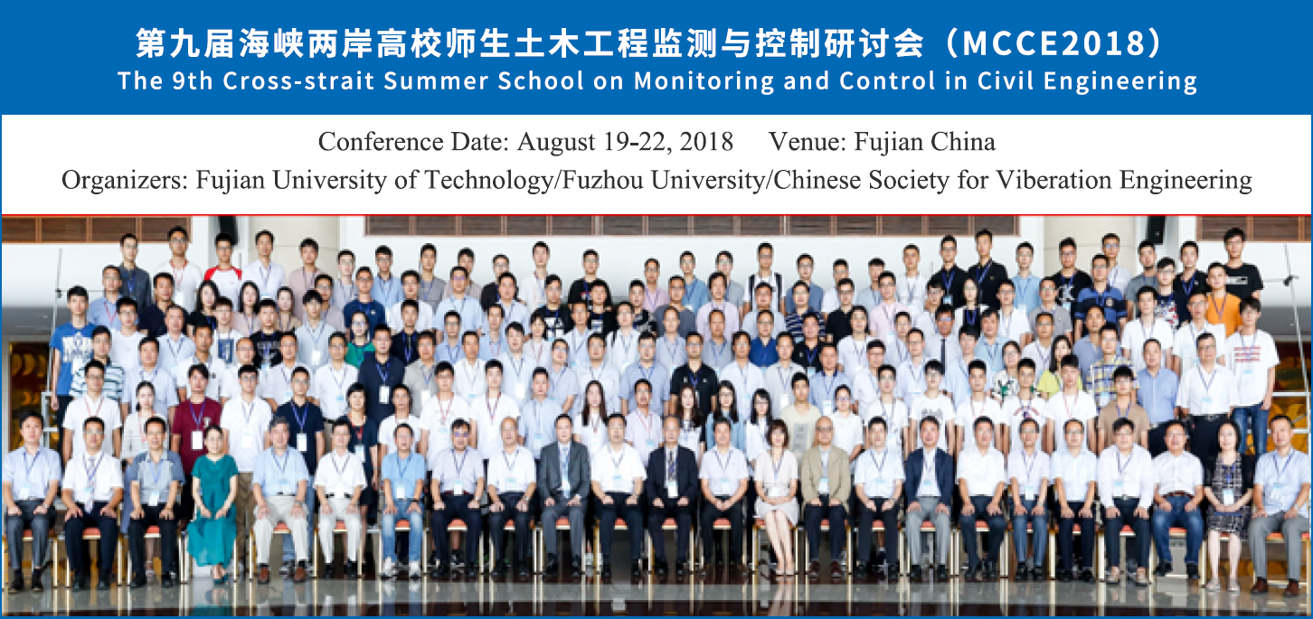
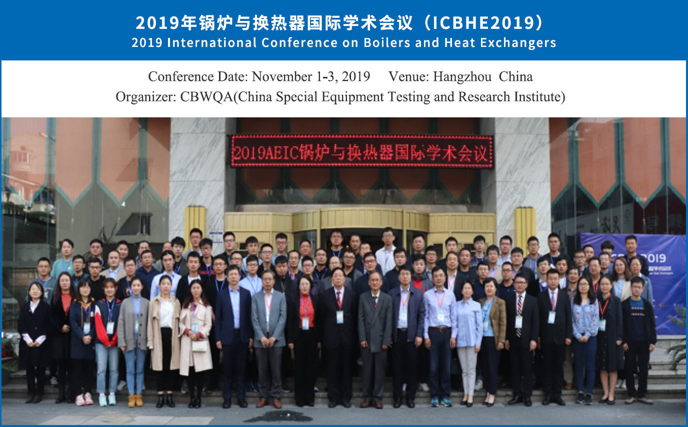
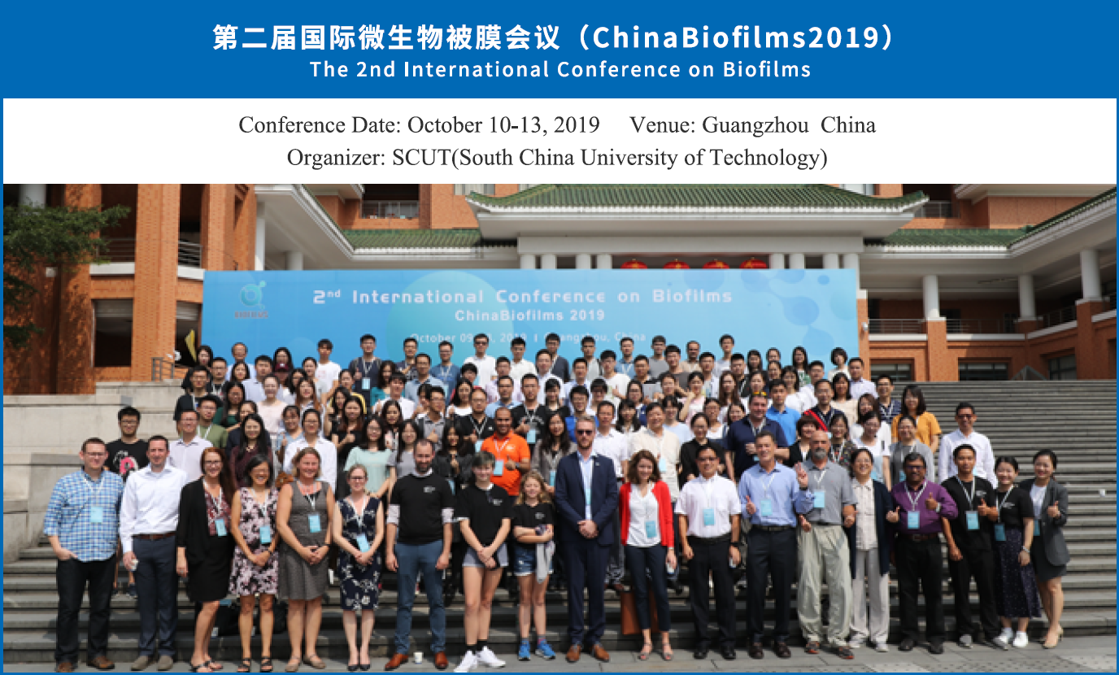
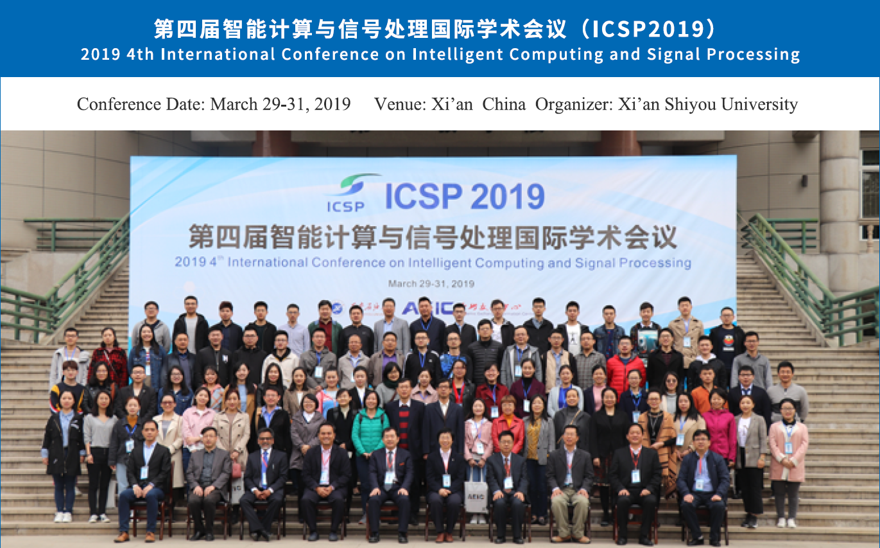
Excellent Cases

Slide 19
四、创新资源
We are still growing!
1,200+
Academic Conferences
2,000+
Research Institutions
1,000,000+
Participants
2,600+
Reviewers
50+
Academicians
3,000+
Experts
80+
Media
300,000
Clients
100+
Collaborated Organizations
500+
International Projects
Global
Coverage
1,000+
Achievements
Establish an Academic Ecosystem

Slide 20
Good luck & Questions!
www.aischolar.org

Slide 21
Good luck and Questions!
www.aischolar.org

